Slide 1
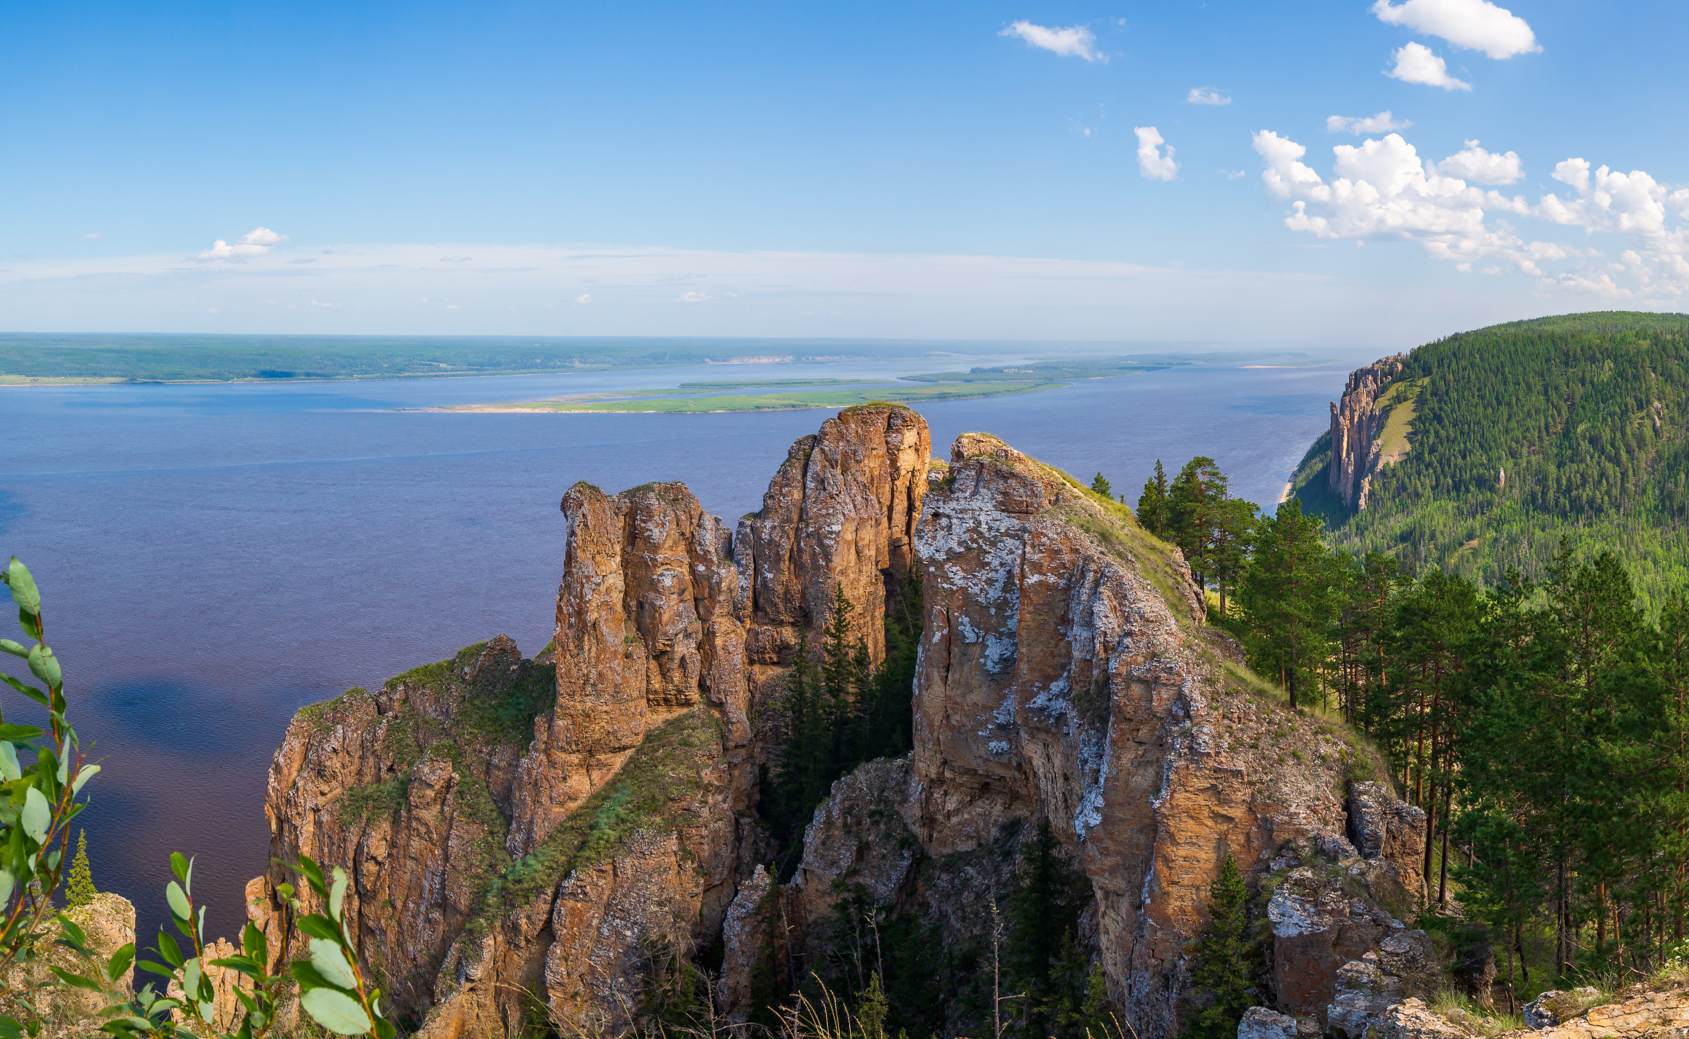

Analysis of mass variation in the Lena river basin using GRACE.
AESM5210C - David Haasnoot
Photo: Andrei Berezovskii, istockphoto.com
Notes:
Hello everybody, I’ll be presenting my project on the mass variations in the Lena Basin

Slide 2
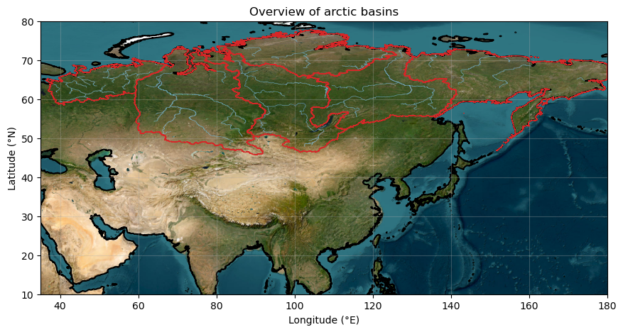
Why are mass variations in the arctic important?
Fresh water discharge arctic ocean
Global ocean circulation
Sea level rise
Region affected by Climate change
Notes:
I’d like to start with why we are interested in mass variations in the arctic basins in the first place.
On the map you the rivers which drain into the arctic ocean from Eurasia.
These discharge fresh water onto a fairly salty ocean which can in turn effect how the global ocean circulation is driven
Secondly mass knowing mass changes on land can help understand sea level rise.
The region is also affected by climate change a lot so knowing how this translates into mass changes is interesting to research.

Slide 3
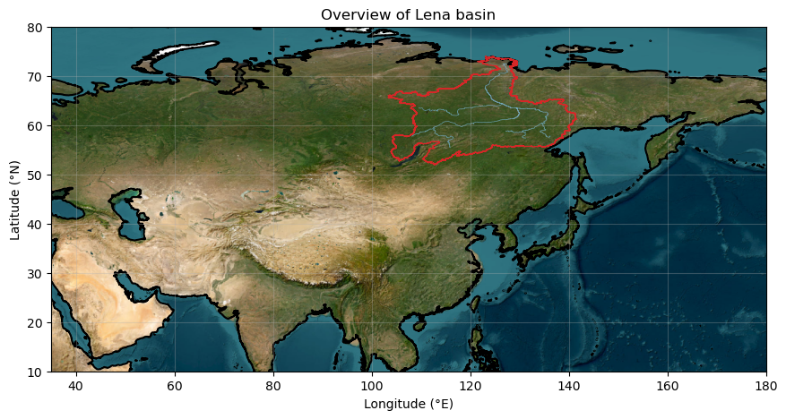
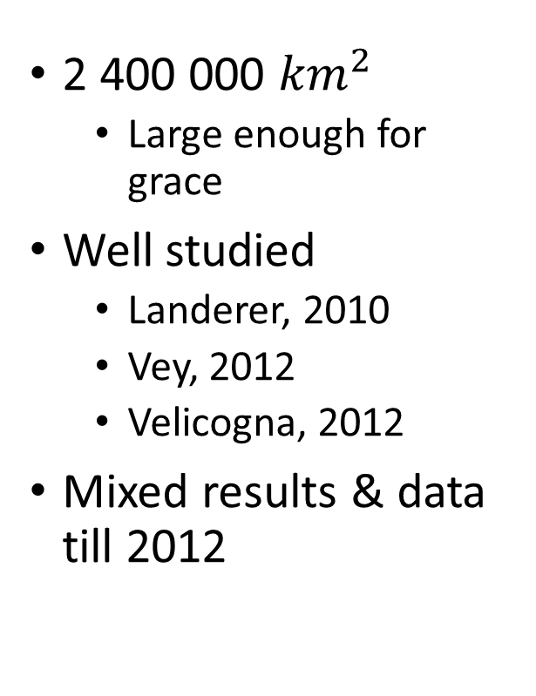
Lena Basin
2 400 000 ${km}^{2}$
Large enough for grace
Well studied
Landerer, 2010
Vey, 2012
Velicogna, 2012
Mixed results & data till 2012
Notes:
From these basin I studie the Lena basin.
Its 2.4 million square kilometers.
There have also been other studies into the area, however they only had 10 years of data and didn’t agree on one trend

Slide 4
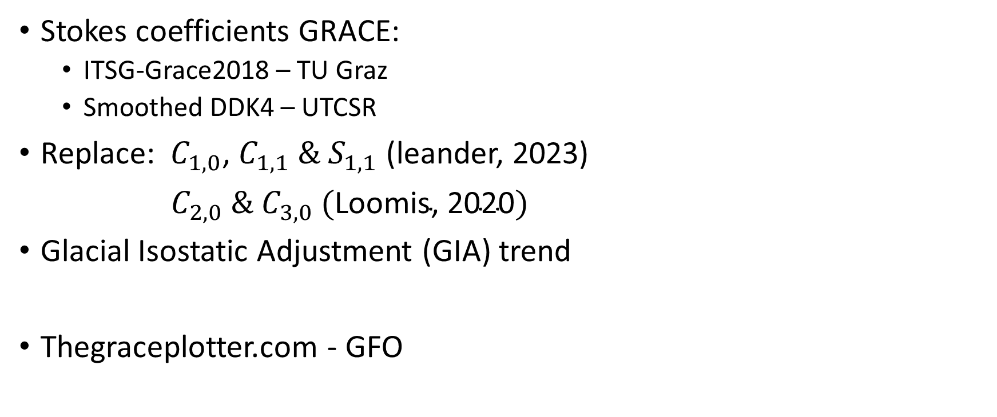
Data
Stokes coefficients GRACE:
ITSG-Grace2018 – TU Graz
Smoothed DDK4 – UTCSR
Replace: $C_{1,0}$, $C_{1,1} \& S_{1,1}$ (leander, 2023)
$C_{2,0} \& C_{3,0} (\text{Loomis}\text{, }\text{2020})$
Glacial Isostatic Adjustment (GIA) trend
Thegraceplotter.com - GFO
Notes:
The data used was the stokes coefficients from the TU Graz & a smoothed version from the university of Texas centre for space research.
I replaced the order 1 coefficients as well as the level 2,0 in favour of more accurate ones., Then also added a Glacial Isostatic adjustment trend.
Finally, to verify these steps went well I used data from the graceplotter to compare my findings to.

Slide 5
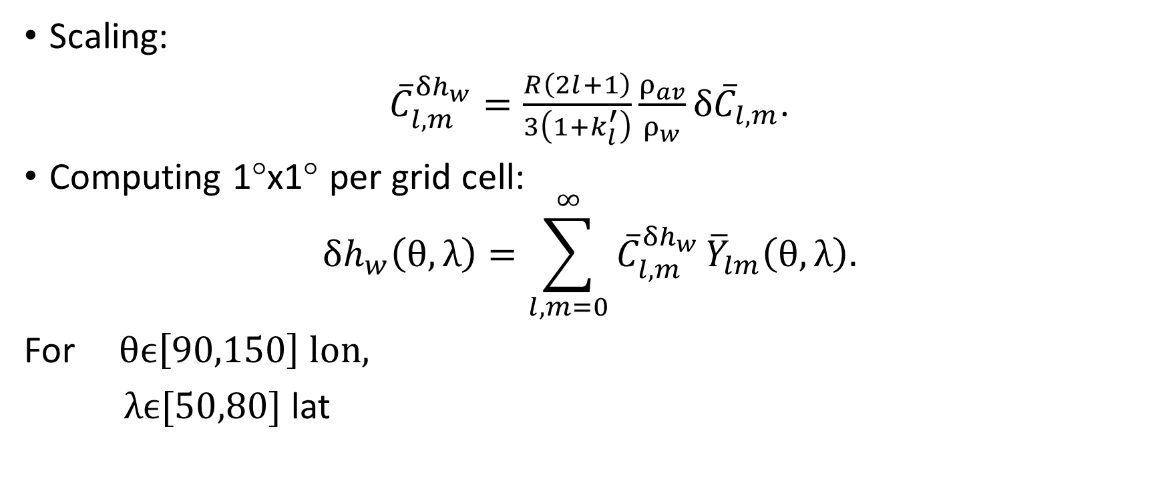
Processing stokes coefficients
Scaling:
${\overline{C}}_{l,m}^{δh_{w}}=\frac{R\left(2l+1\right)}{3\left(1+k_{l}^{′}\right)}\frac{ρ_{av}}{ρ_{w}}{δ\overline{C}}_{l,m}$.
Computing 1°x1° per grid cell:
$$δh_{w}\left(θ,λ\right)=\sum_{l,m=0}^{∞}{{\overline{C}}_{l,m}^{δh_{w}}}{\overline{Y}}_{lm}\left(θ,λ\right).$$
For $θϵ\left[90,150\right] lon,$
$λϵ[50,80]$ lat
Notes:
We can scale the coefficients to equivalent water heights using the top equation. (Using the lovenumbers and the pav/pw = 5. )
And calculate for a 1x1° gridcell as shown in the lower equation.

Slide 6
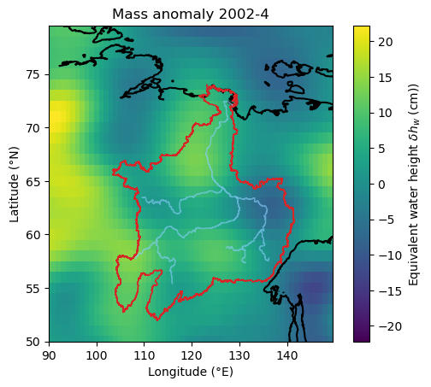
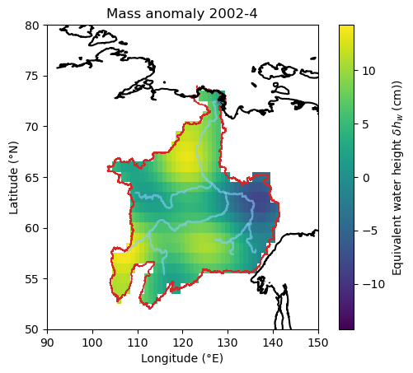
Maps of equivalent water height anomaly
Notes:
From this we obtain a map as following. Which can then be masked to just keep the area in the basin and we can then in turn obtain the mean of this value

Slide 7
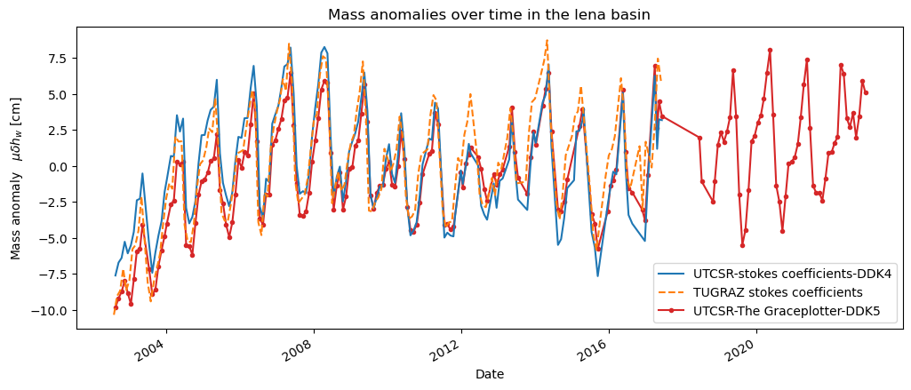
Timeseries
Notes:
This yields the time series as followed …
We see all three are fairly close. The smoothed time series seems somewhat better and thus is used preliminary.

Slide 8
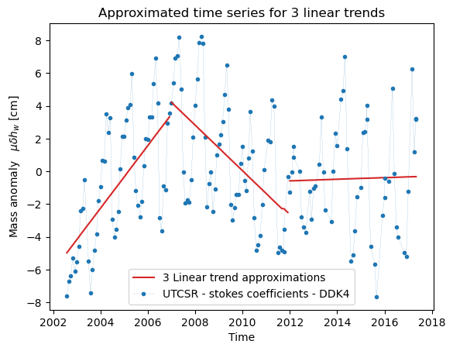
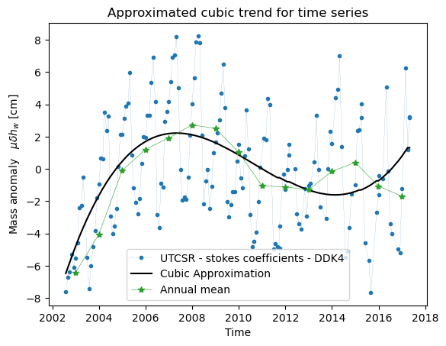
Trend – linear & cubic
RMSE = 3,15cm
RMSE = 3,21cm
Notes:
We can try a set of different trend lines. When we consider a linear trendline, we see that there is defitely some change. These still have fairly high RMSE values.

Slide 9
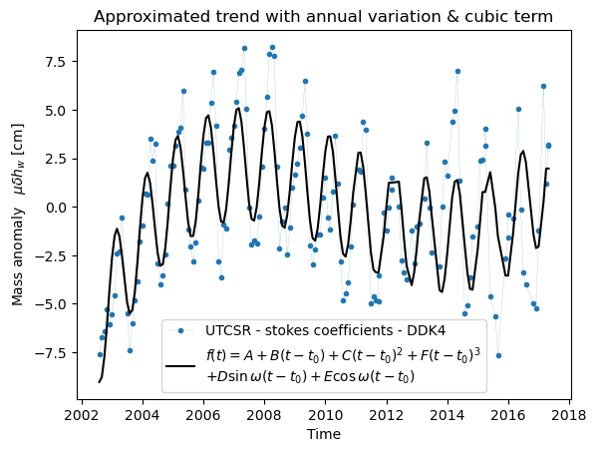
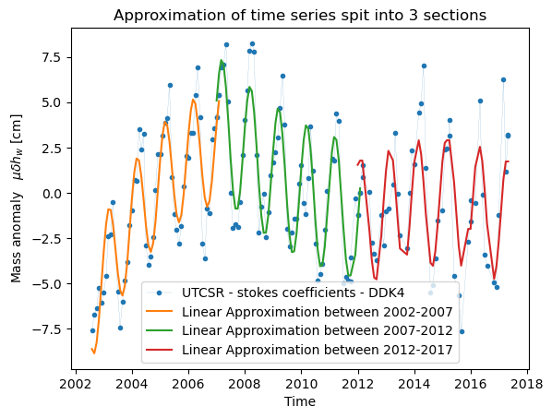
Trend – annual with cubic & split in 3
$$f\left(t\right)=A+B\left(t−t_{0}\right)+C{\left(t−t_{0}\right)}^{2}+D\sin{ω}\left(t−t_{0}\right)+E\cos{ω}\left(t−t_{0}\right)$$
RMSE = 2,41cm
RMSE = 1,84cm
Notes:
When we try include an annual signal we can obtain a better fit. Splitting the time series into 3 improves this even more.

Slide 10
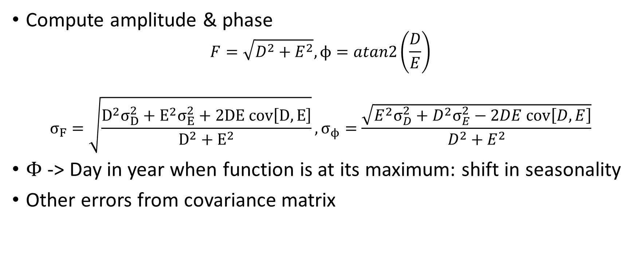
Process coefficients
Compute amplitude & phase
$$F=\sqrt{D^{2}+E^{2}},ϕ=atan2\left(\frac{D}{E}\right)$$
$$σ_{F}=\sqrt{\frac{D^{2}σ_{D}^{2}+E^{2}σ_{E}^{2}+2DE cov\left[D,E\right]}{D^{2}+E^{2}}}, σ_{ϕ}=\frac{\sqrt{E^{2}σ_{D}^{2}+D^{2}σ_{E}^{2}−2DE cov\left[D,E\right]}}{D^{2}+E^{2}}$$
$Φ$ -> Day in year when function is at its maximum: shift in seasonality
Other errors from covariance matrix
Notes:
We can process these coefficients to obtain amplitude and phase.

Slide 11
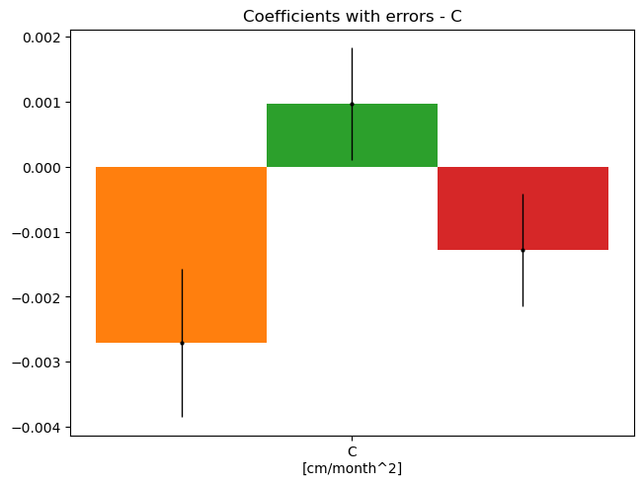
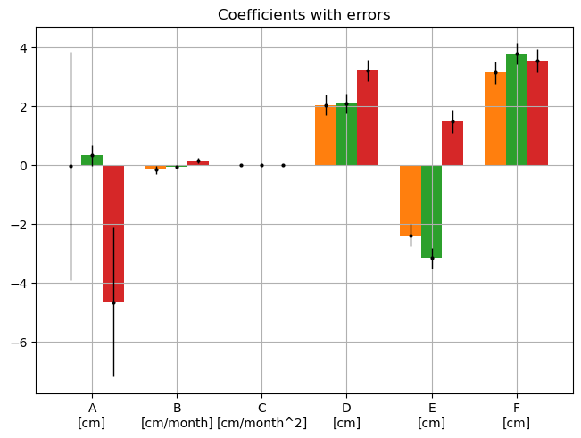
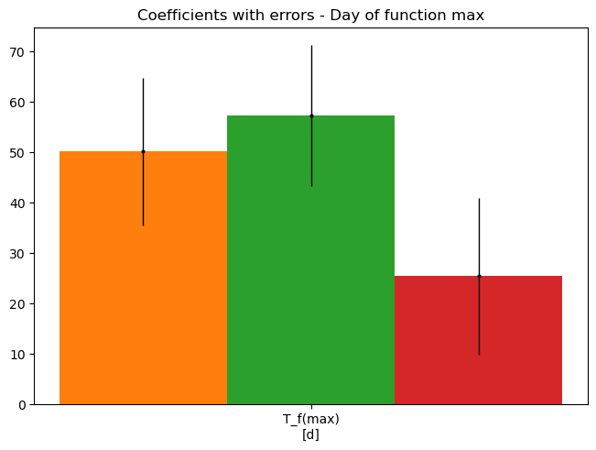
Coefficients significance
Notes:
And using the covariance matrix and error propagation we can look at the different coefficients. Using the 3 sigma rule we can say coefficients are significant if they are larger than the noise.The trend is significant for all except the intercept which seems to have some noise issues.

Slide 12
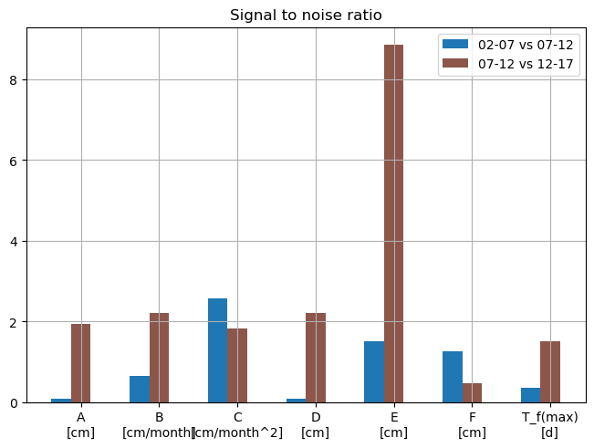
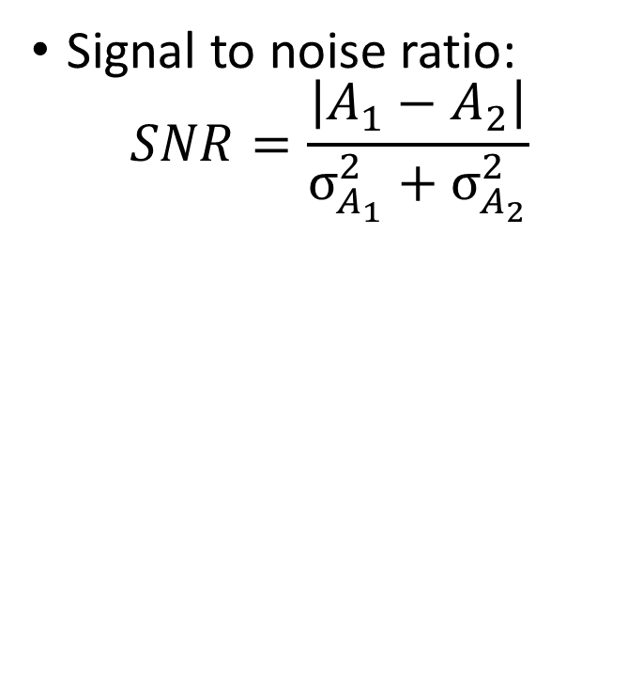
Change in trend
$$f\left(t\right)=A+B\left(t−t_{0}\right)+C{\left(t−t_{0}\right)}^{2}+D\sin{ω}\left(t−t_{0}\right)+E\cos{ω}\left(t−t_{0}\right)$$
Signal to noise ratio:
$$SNR=\frac{\left|A_{1}−A_{2}\right|}{σ_{A_{1}}^{2}+σ_{A_{2}}^{2}}$$
$t_{0}$= Oct 2009
Notes:
To see if the changes are significant, we can look at the signal to noise ratio of the coefficients of two periods. There is a slight change in the magnitude of the cosine function however this is not really seen back in the magnitude or the day to function maximum.

Slide 13
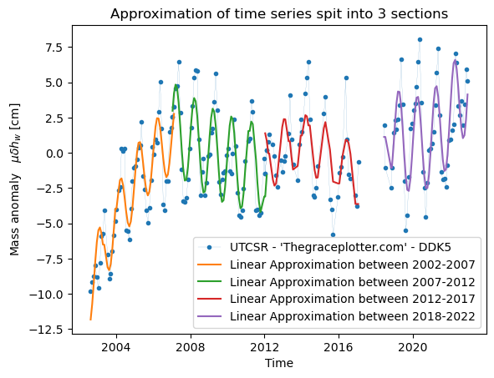
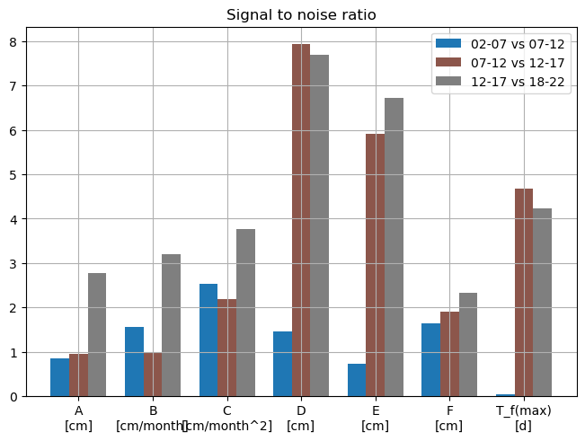
Change in trend – ‘Thegraceplotter’
$$f\left(t\right)=A+B\left(t−t_{0}\right)+C{\left(t−t_{0}\right)}^{2}+D\sin{ω}\left(t−t_{0}\right)+E\cos{ω}\left(t−t_{0}\right)$$
Notes:
We can then repeat this for the longer data set the grace follow on mission had. We see more clear changes in this data set. Over time.

Slide 14
Conclusion
Including GFO data shows clear trend
Long term variability
More effort into reducing error/attaining better fit
Allows more precise attribution of change
Notes:
We can then repeat this for the longer data set the grace follow on mission had. We see more clear changes in this data set. Over time.

Slide 15
Questions?

Slide 16
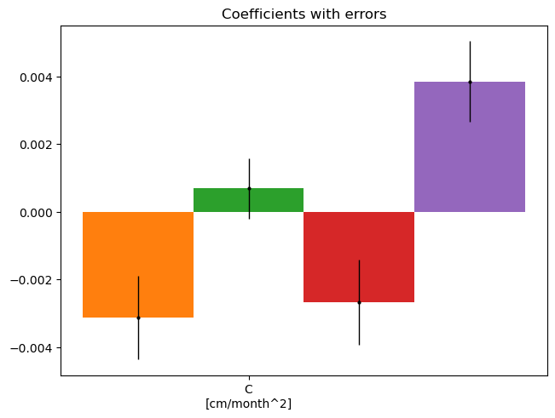
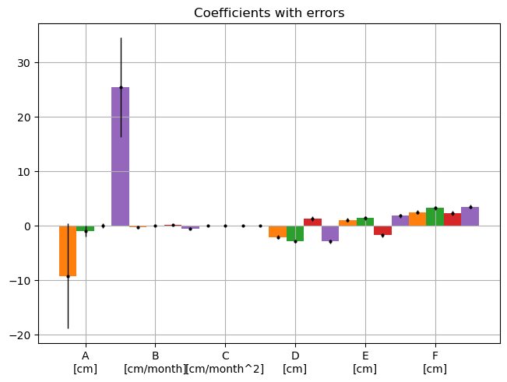
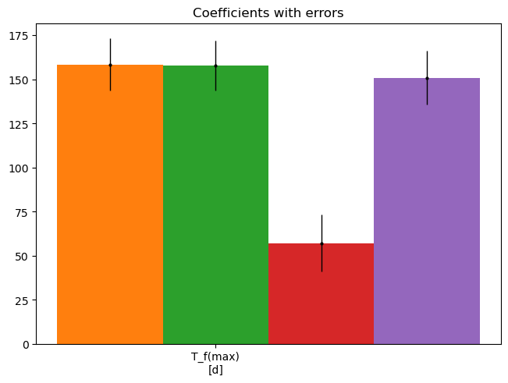
Coefficients significance – grace plotter
Notes:
Same for graceplotter

